Slide 1
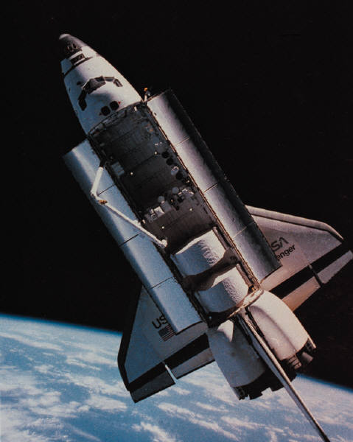
The Elite 6
Maddie, Tony, Matt, & Kylie

Slide 2
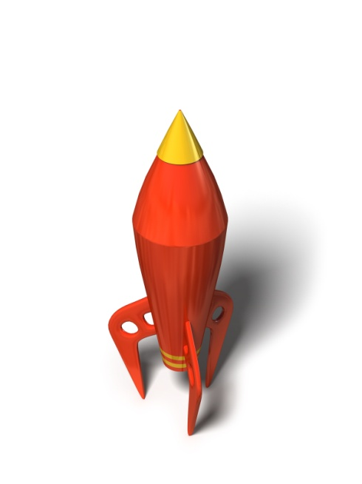
Picking our Jobs
Tony’s job was folder organizer, Maddie’s job was procedure, Kylie’s job was time and calculator, and Matt’s job was the designer.

Slide 3
Problem question
How to make our egg survive? Have a soft cone. How to make our rocket go high? Have a lot of pressure. How much water we should put in our rocket? We should have 80z.

Slide 4
Materials used
We had cotton balls, bottle, a paper cone, paper fins, bubble wrap, and an egg.

Slide 5
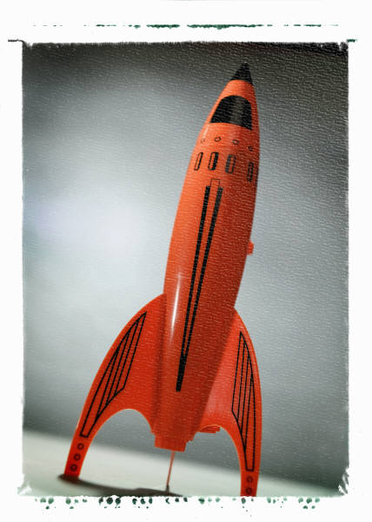
Building procedure
We made eggie’s bed.
Then we stuffed the cone with cotton balls.
We made cotton wrap for our egg.
Then we taped our cone on .

Slide 6
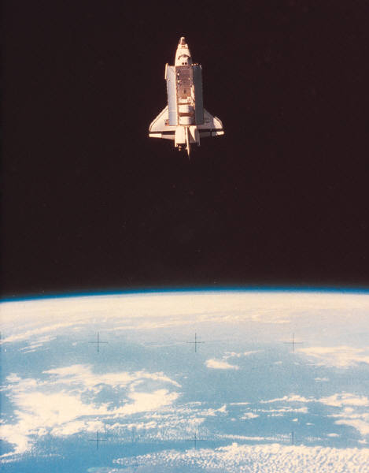
Launching procedure
We put our rocket on the platform.
We filled the rocket up with air.
We pulled the string and launched the rocket.

Slide 7
Hypothesis/Prediction
We predicted that our rocket will go about 3 feet in the air.
We predicted that our rocket will stay about 3 seconds in the air.
We also predicted our egg will survive.

Slide 8
Graph

Slide 9
Comparison
80 psi’s
Air
Cotton
Eggs died
Same bottle
Same cone size
Same fins

Slide 10

Conclusion
It had fuel. The water/air launch was higher and longer. We used bubble wrap for water/air launch. We put water in one.

Slide 11
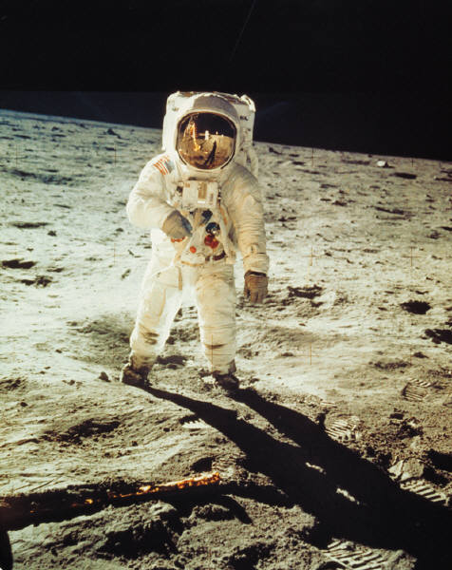
Kylie

Slide 12



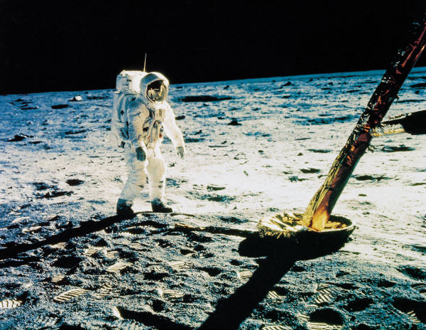
Maddie

Slide 13

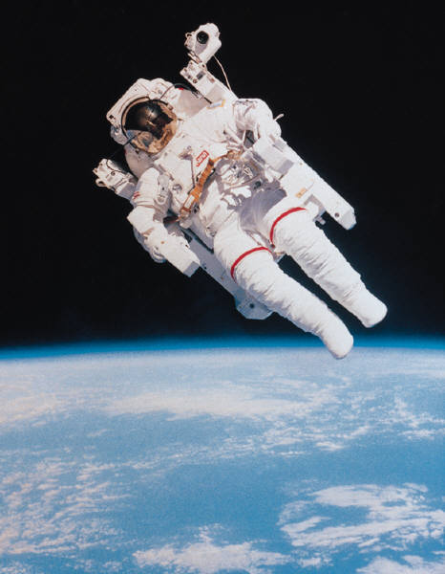
Matthew

Slide 14
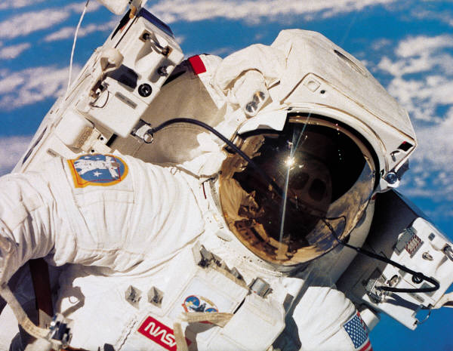
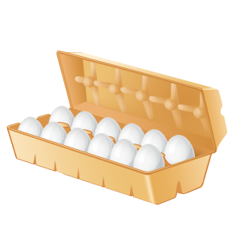
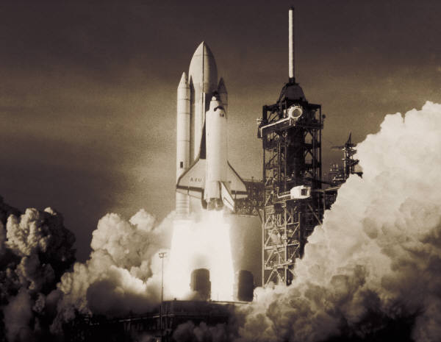
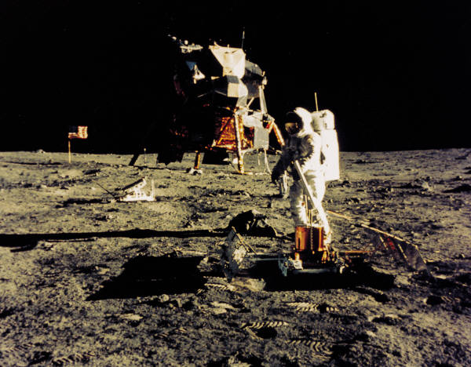

Tony
THE END!

